Slide 1
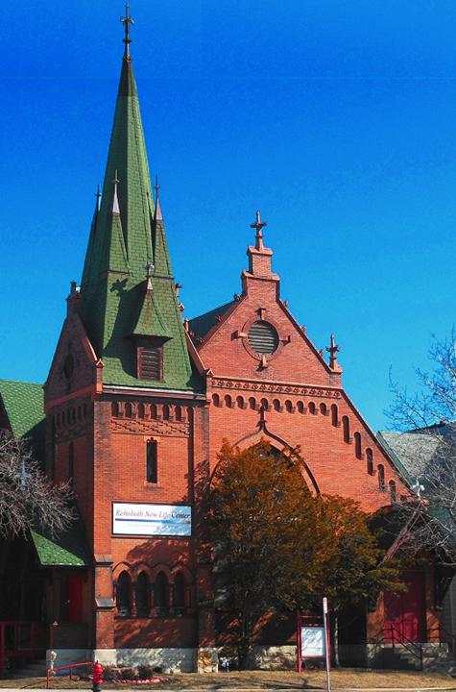
Welcome to Rehoboth New Life Center
Sunday Study
July 19th 2015

Slide 2
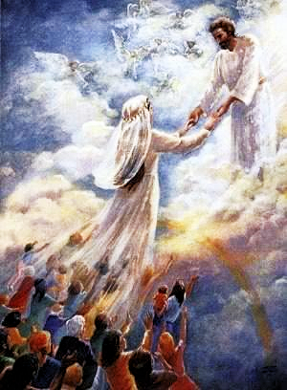
The Bride Of Christ
The Marriage supper II
Matthew 22:4 Again, he sent forth other servants, saying, Tell them which are bidden, Behold, I have prepared my dinner: my oxen and my fatlings are killed, and all things are ready: come unto the marriage.

Slide 3
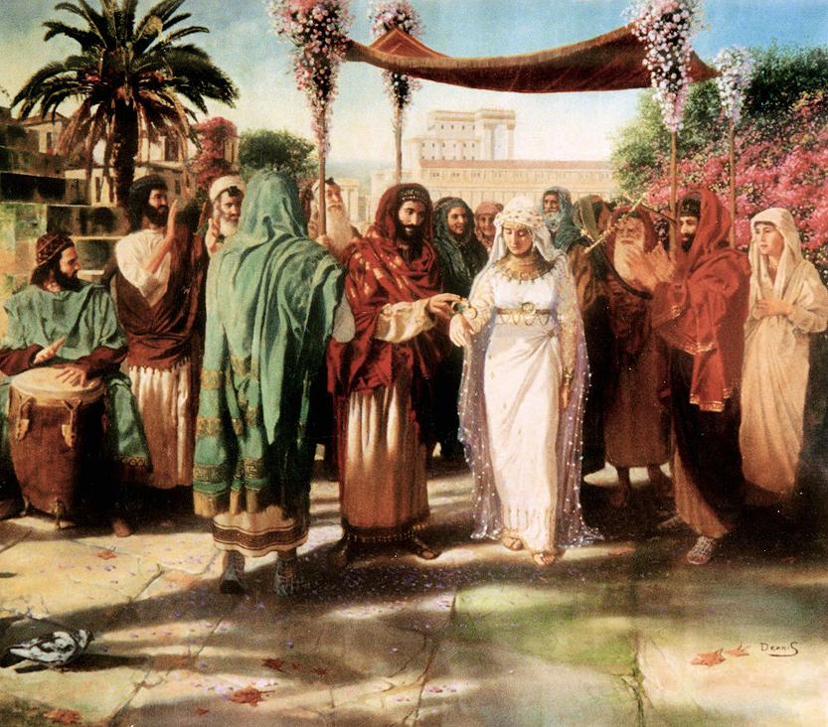
The Wedding
John 2:1 And the third day there was a marriage in Cana of Galilee; and the mother of Jesus was there:
2 And both Jesus was called, and his disciples, to the marriage.

Slide 4
The Wednesday Wedding
John 2:1 And the third day there was a marriage in Cana of Galilee; and the mother of Jesus was there:

Slide 5
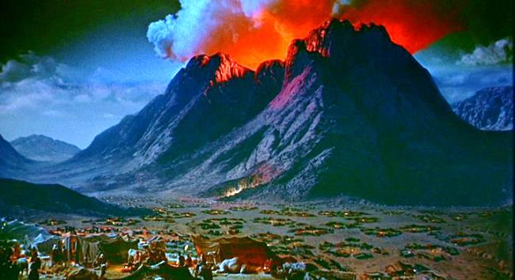
The Third Day!
Exodus 19:1 In the third month, when the children of Israel were gone forth out of the land of Egypt, the same day came they into the wilderness of Sinai.
Exodus 19:11 And be ready against the third day: for the third day the LORD will come down in the sight of all the people upon mount Sinai.

Slide 6
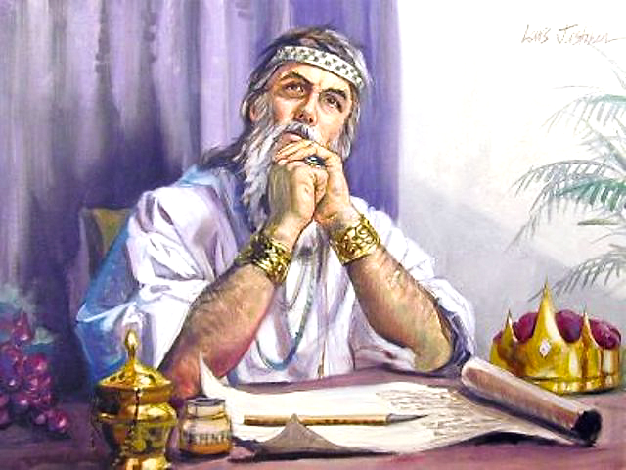
The Day of Meeting and Miracles!
2 Kings 20:5
Turn again, and tell Hezekiah the captain of my people, Thus saith the LORD, the God of David thy father,
I have heard thy prayer, I have seen thy tears: behold, I will heal thee: on the third day thou shalt go up unto the house of the LORD.

Slide 7
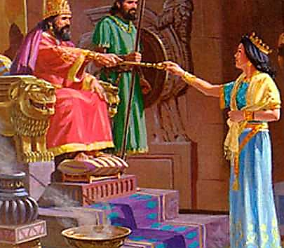
The Day of Meeting and Miracles!
Esther 5:1 ¶Now it came to pass on the third day, that Esther put on her royal apparel, and stood in the inner court of the king's house, over against the king's house: and the king sat upon his royal throne in the royal house, over against the gate of the house.
2 And it was so, when the king saw Esther the queen standing in the court, that she obtained favour in his sight: and the king held out to Esther the golden sceptre that was in his hand. So Esther drew near, and touched the top of the sceptre.

Slide 8
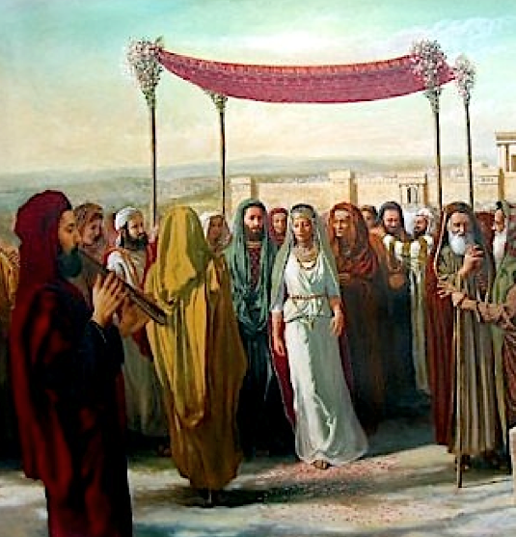
The Wedding
John 2:1 And the third day there was a marriage in Cana of Galilee; and the mother of Jesus was there:
Hosea 6:2 After two days will he revive us: in the third day he will raise us up, and we shall live in his sight.

Slide 9
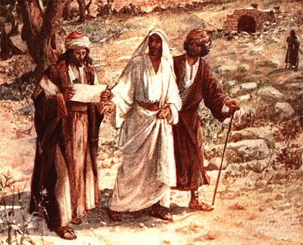
Many are Called…
John 2:2 And both Jesus was called, and his disciples, to the marriage.
Matthew 22:14 For many are called, but few are chosen.
Matthew 22:10 So those servants went out into the highways, and gathered together all as many as they found, both bad and good: and the wedding was furnished with guests.

Slide 10
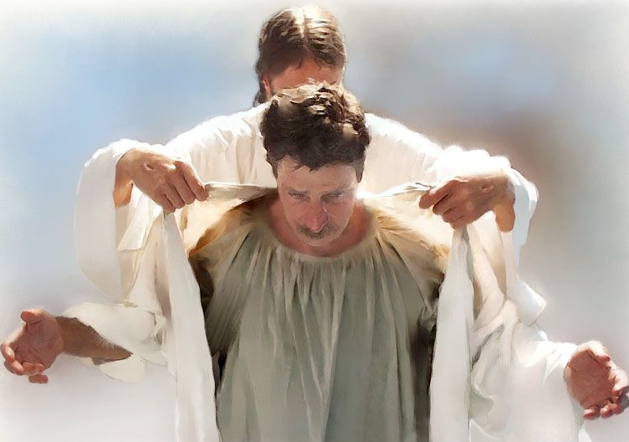
The Wedding Garment
Revelation 19:8 And to her was granted that she should be arrayed in fine linen, clean and white: for the fine linen is the righteousness of saints.
He that overcometh, the same shall be clothed in white raiment; and I will not blot out his name out of the book of life, but I will confess his name before my Father, and before his angels. Revelation 3:5
Romans 3:21 But now the righteousness of God without the law is manifested, being witnessed by the law and the prophets;
22 Even the righteousness of God which is by faith of Jesus Christ unto all and upon all them that believe: for there is no difference:

Slide 11
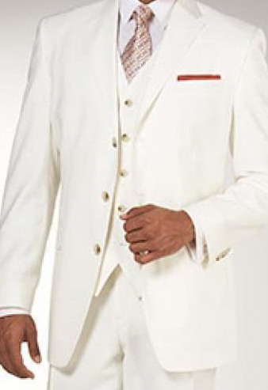
The Wedding Garment
Romans 13:14 But put ye on the Lord Jesus Christ, and make not provision for the flesh, to fulfil the lusts thereof.
Galatians 3:27 For as many of you as have been baptized into Christ have put on Christ.

Slide 12
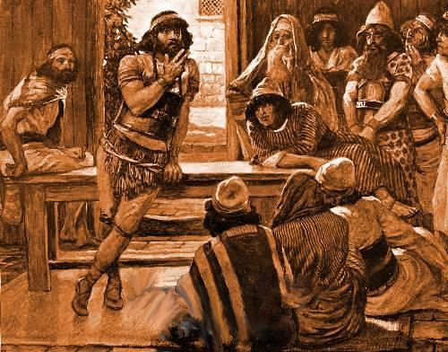
Thirty pieces of…The cost
Judges 14:12 And Samson said unto them, I will now put forth a riddle unto you: if ye can certainly declare it me within the seven days of the feast, and find it out, then I will give you thirty sheets and thirty change of garments:
The wedding of Samson

Slide 13
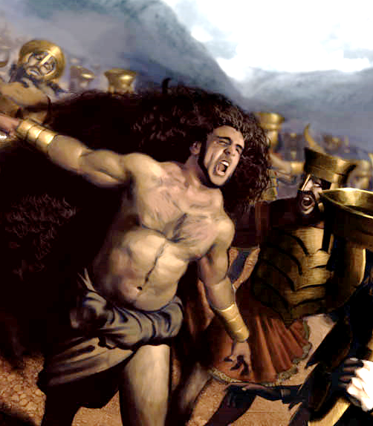
The Cost of the Wedding Garment
Judges 14:19 And the Spirit of the LORD came upon him, and he went down to Ashkelon, and slew thirty men of them, and took their spoil, and gave change of garments unto them which expounded the riddle. And his anger was kindled, and he went up to his father's house.
Judges 14:14 And he said unto them, Out of the eater came forth meat, and out of the strong came forth sweetness. And they could not in three days expound the riddle.

Slide 14
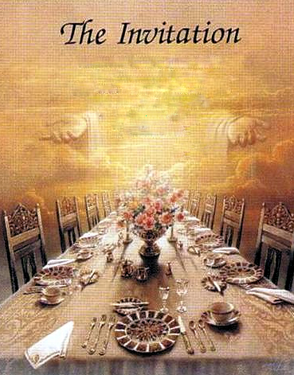
The Servants Announce!
Revelation 19:9
And he saith unto me, Write, Blessed are they which are called unto the marriage supper of the Lamb. And he saith unto me, These are the true sayings of God.
John 6:44 No man can come to me, except the Father which hath sent me draw him: and I will raise him up at the last day.

Slide 15
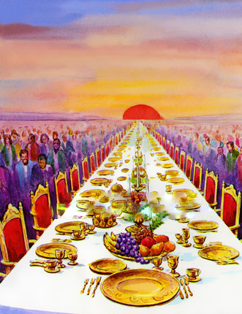
The Invited
Matthew 8:11 And I say unto you, That many shall come from the east and west, and shall sit down with Abraham, and Isaac, and Jacob, in the kingdom of heaven.
Revelation 7:13 ¶And one of the elders answered, saying unto me, What are these which are arrayed in white robes? and whence came they?
14 And I said unto him, Sir, thou knowest. And he said to me, These are they which came out of great tribulation, and have washed their robes, and made them white in the blood of the Lamb.

Slide 16
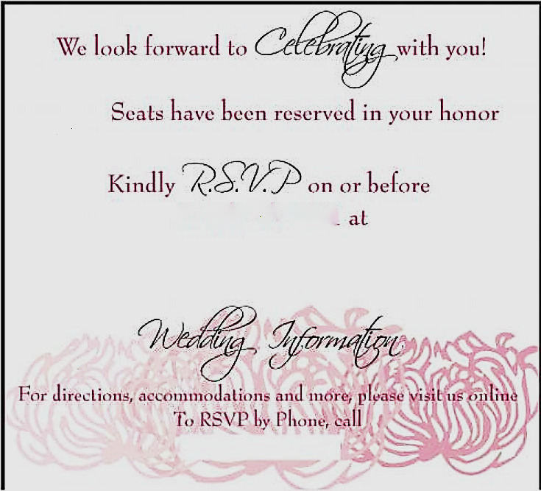
RSVP ?
Revelation 22:16 I Jesus have sent mine angel to testify unto you these things in the churches. I am the root and the offspring of David, and the bright and morning star.
17 And the Spirit and the bride say, Come. And let him that heareth say, Come. And let him that is athirst come. And whosoever will, let him take the water of life freely.

